Slide 1
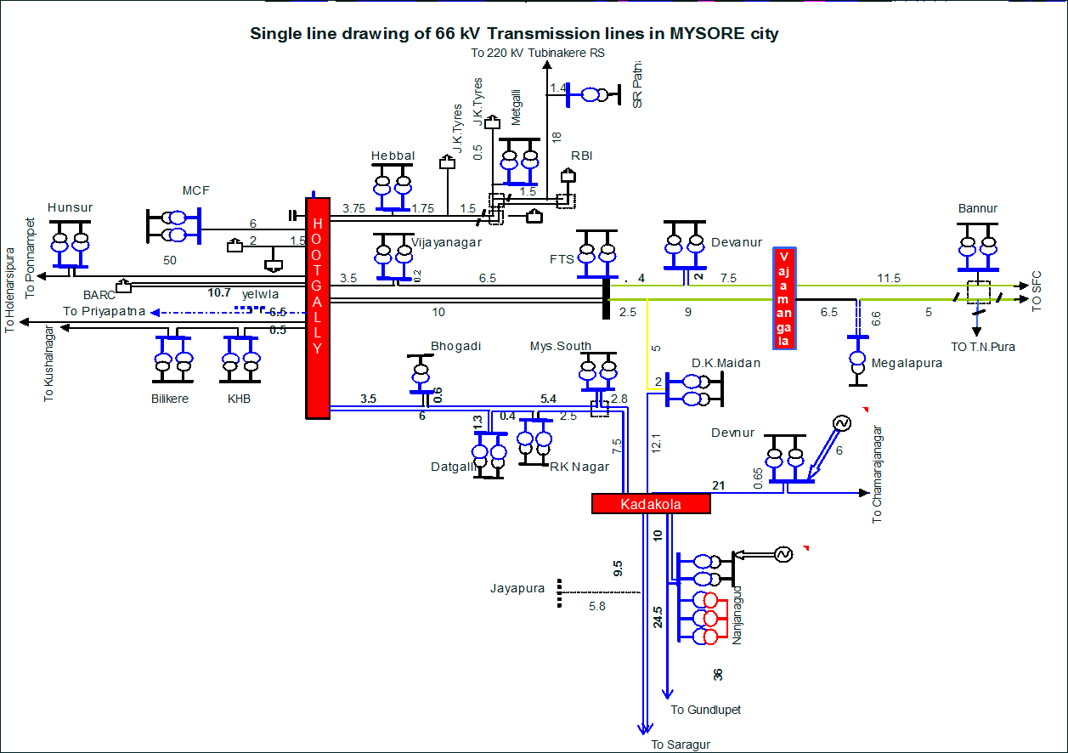
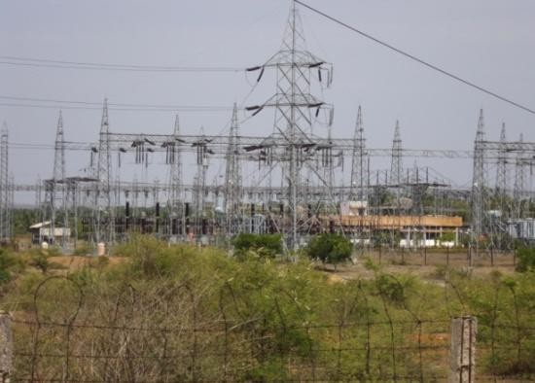
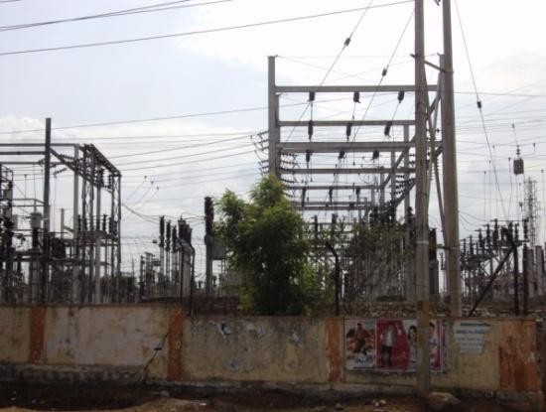
4.STREET LIGHTS
URBAN CORE INFRASTRUCTURE
According to the Urban and Regional Development Plans Formulation & Implementation (URDPFI) Guidelines, street lighting in urban areas should be provided at regular intervals to ensure safety and visibility.
Typically, street lights are recommended to be installed at intervals of 30 to 50 meters along roads and streets in urban areas.
Street Lights:
Smart Street Lighting System:
A smart street lighting system is an advanced, automated lighting solution designed to improve the efficiency, functionality, and sustainability of traditional street lighting.
Key Features of a Smart Street Lighting System
1.Energy Efficiency: Utilizes energy-efficient LEDs and intelligent control to minimize electricity consumption.
2.Automation: Automatically adjusts brightness based on factors like traffic, motion, or ambient light.
3.Remote Monitoring and Control: Allows city operators to manage lights remotely through a centralized dashboard.
4.Real-Time Data Collection: Equipped with sensors to monitor light levels, weather conditions, and maintenance needs.
5.Adaptive Lighting: Lights can dim during low-traffic hours or brighten in areas with high activity.
6.Integration with Smart City Systems: Can be linked to systems like traffic management, surveillance, and environmental monitoring.
Electricity in Mysore
Chamundeshwari Electricity Supply Corporation (CHESCOM) is the nodal agency for the power distribution within Mysore
Mysore receives its power mainly from the hydropower generation. Hence, it is dependent on the rainfall and water availability.
Roadways:
Atal Mission for Rejuvenation and Urban Transformation -AMRUT :
To provide basic civic amenities like water supply, sewerage, urban transport, parks as to improve the quality of life for all especially the poor and the disadvantaged.
The focus of the Mission is on infrastructure creation that has a direct link to provision of better services to the citizens
Kadakola sub station
Hebbal Substation
5.TRANSPORTATION(ROAD NETWORK)
SCHOOL OF PLANNING AND ARCHITECTURE
NAME: MAHAM KAUSAR
REV/EXM:03
DISTRICT DEVELOPMENT PLAN FOR MYSURU DISTRICT
CLASS:3rd Sem, MTech in URP
DRW:05
REG NO:P01ZZ23T107004

